Slide 1
Comparison of classification algorithm using WaterQuality dataset
By Asmellash G/Yesus

Slide 2
Dataset description
Dataset name: WaterQuality Dataset
Owner of the dataset: Ankit Raj
Dataset size : 9.15 KB (9,373 bytes)
Number of features: 17
Label Value (Predictive value): waterQuality

Slide 3
The water Quality dataset has 88 observational and 17 features class distribution: i.e. Label Value (Predictive value): 4. Is that balanced or not? Not balance because one class dominates the other class.

Slide 4
Dataset | Classification algorithms | Accuracy | Precision | F-Measure
Water Quality | DT | 0.78 | 0.43 | 0.45
 | SVM | 0.83 | 0.48 | 0.5
 | KNN | 0.78 | 0.46 | 0.46
 | NB | 0.67 | 0.38 | 0.35

Slide 5
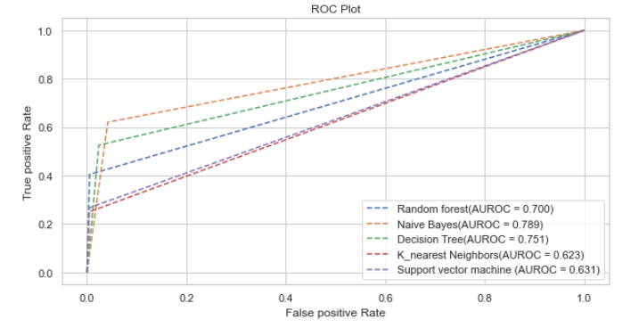
ROC-AUC Curve comparison

Slide 6
What will happen after Ensemble Implementation
Accuracy 0.78
Reason: because since the the dataset are not balance

Slide 7
Your Remark or conclusion
In the distribution of class that the data is not balanced among algorithm that I had mentioned on the above table I got the highest accuracy in support vector machine algorithm
For the precision and F-Measure I had used the the macro avg since it is unbalanced data
For precision=the sum of all the value of the class/5
For F-Measure = 2x(macro avg of precision * macro avg of Recall)/macro avg of precision + macro avg of Recall

